Slide 1
Introduction to Statistics for Data Analytics
© Oluwatosin Oluwadare, Ph.D. 2024
Department of Computer Science , University of Colorado, Colorado springs.
CS 2020 and dase 2020
Introduction to statistics for data analystics
Spring 2024
Lecture 1: Course Overview

Slide 2
Introduction
Oluwatosin Oluwadare Ph.D.
Assistant Professor of Computer Science and Bachelor of Innovation
Office: Engineering Building - ENG 244
Phone: 719-255-3004
E-mail: ooluwada@uccs.edu
Website: https://uccs-bioinformatics.com/oluwatosin-oluwadare/

Slide 3
Research
Bioinformatics & Computational Biology
Machine learning & Data Mining
Deep Learning & Reinforcement Learning
Read more about my Research here:
GoogleScholar, ResearchGate, LinkedIn, PubMed

Slide 4
Other Classes I Teach
CS 4435/5435 - Data Mining
CS 3850 - Bioinformatics & Computational Biology (was CS 4850)
ENTP 1000 - Introduction to Entrepreneurship
CS 1120 – Computational Thinking with Beginning Programming ( Intro. To programming in C)
INOV 1010 – The Innovation Process

Slide 5
Now it’s your turn
Name, program
Prior courses/experiences related to this subject
Why did you register for this course?
Anything else

Slide 6
Teaching Assistant
Name: Melkamu Mersha (PhD Student)
Email Address: mmersha@uccs.edu
Office hours: TBD
Office: TBD

Slide 7
About Course
Time: Friday, 9:25am -12:05pm
Classroom: ENG 109
Course Management: Canvas
  For Grades posting and Announcements
Course Schedule/Website:
https://academics.uccs.edu/~ooluwada/courses/dataanalytics/
All Resources, In-Class exercises, Homework, and Assignments will be posted on Canvas and the Course website.

Slide 8
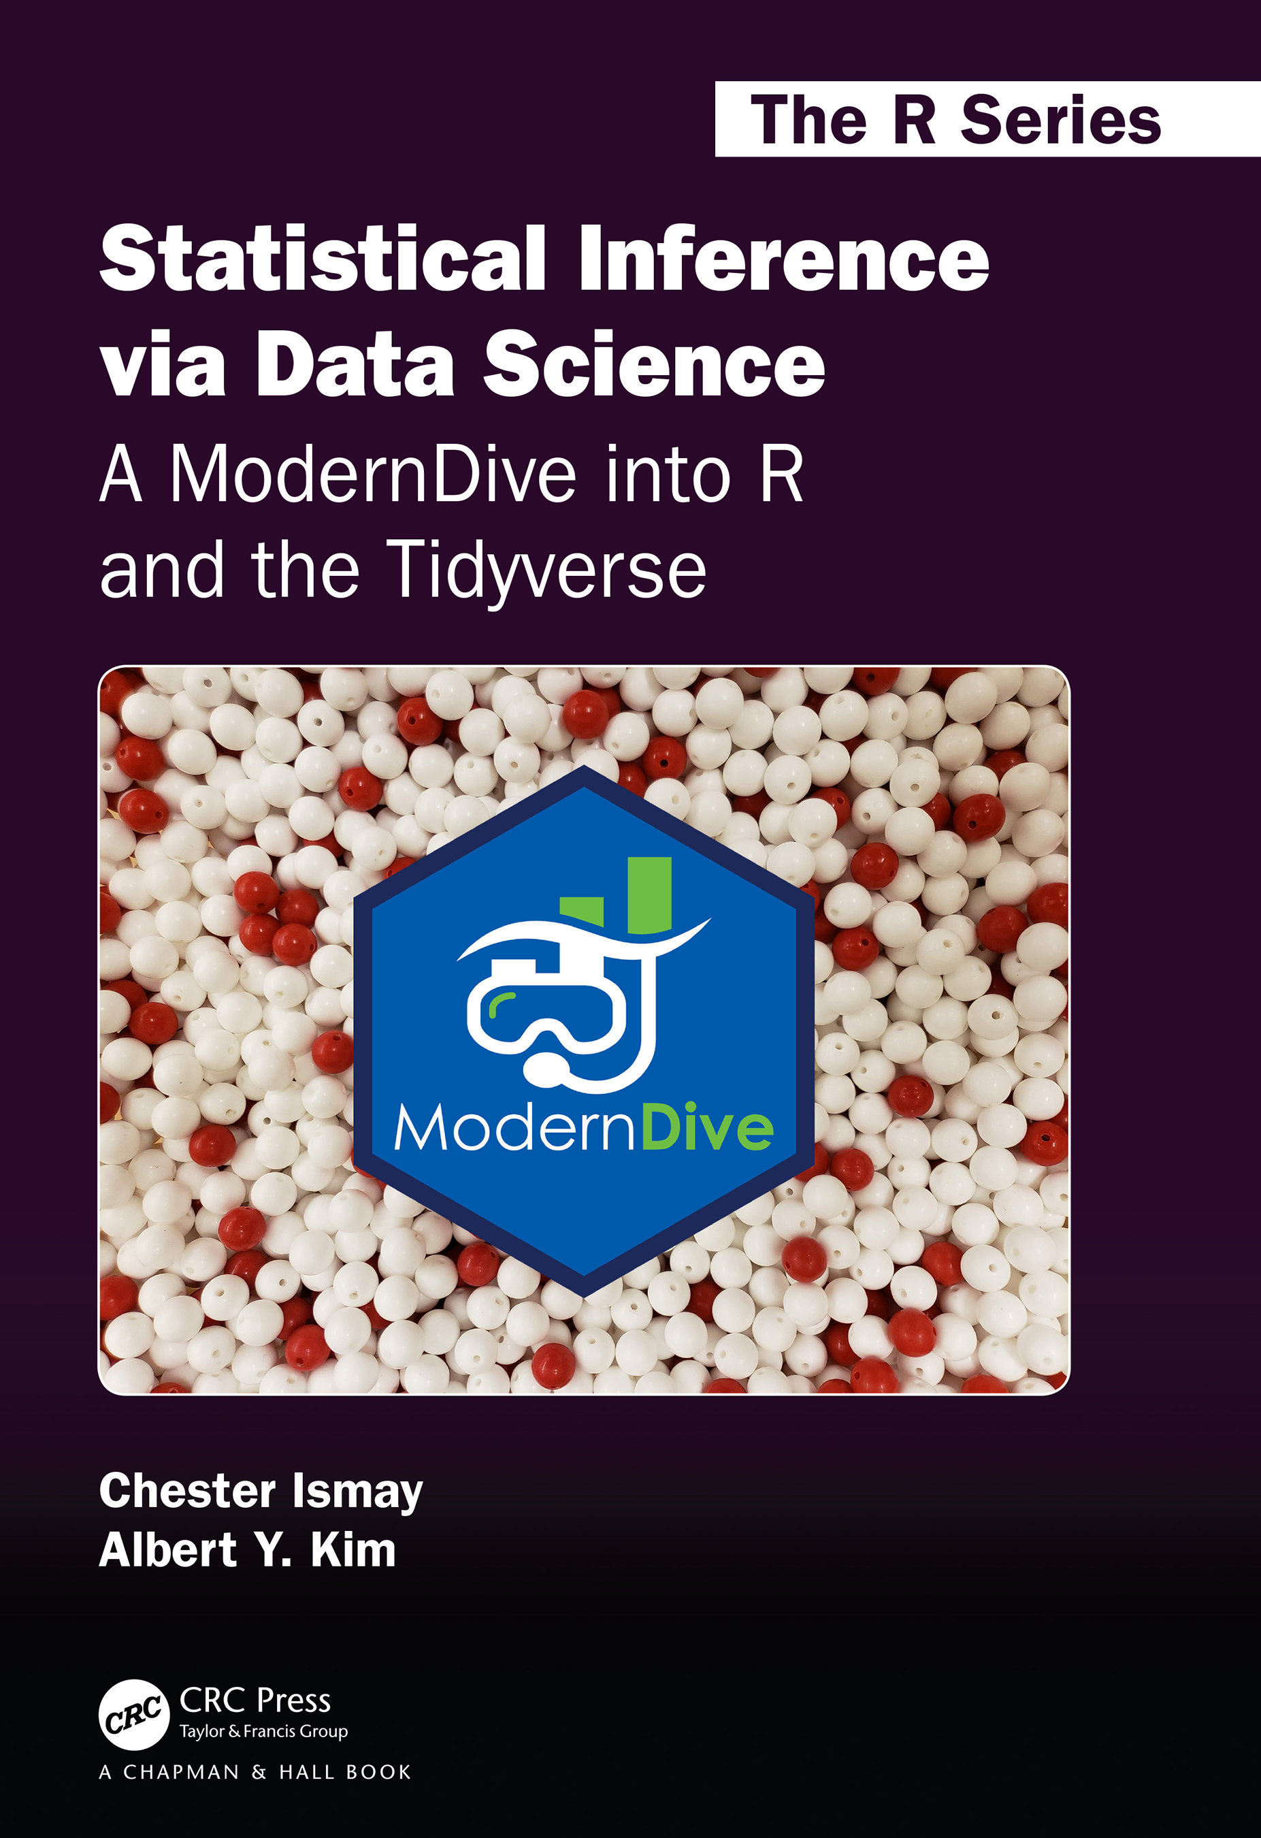
Class Textbook
(Main Textbook) Ismay, Chester, and Albert Y. Kim. Statistical inference via data science: A ModernDive into R and the tidyverse. Chapman and Hall/CRC, 2019. Get an electronic copy from the UCCS Library.
The authors have also uploaded a frequently update open-source copy of the textbook here: https://moderndive.com/
This course is organized to closely follow this textbook chapters.
Alternate Textbook are provided in the syllabus

Slide 9
The Slides
There will be very few slides uploaded but more whiteboard explanation, code writing and in-class textbook review
The slides highlight the gist of most important concepts and techniques.
But
  It is not meant to be complete. Details may not be included.
  It may be simplified for ease of explanation.
Studying only the slides is not enough.
  You need to read the book and study the slides carefully.
This course is organized to closely follow this textbook chapters

Slide 10
Class Expectations
To be successful in this course, you (the student) need to attend every lecture. Students are required to attend lectures. Attendance is Mandatory
Participate in class discussions. Attending class and not participating is the same as Absence for the day.
Ask questions for clarity.
Attendance is taking through submission of learning checks in-class submissions

Slide 11
Class Expectations
All the key class notes interaction will be on the whiteboard.
Bring your personal computer to the class.
  With no computer you will lose point for class activity.
Submit assignments and projects on time.

Slide 12
Class Pre-requisites
General Pre-requisite: Programming experience and a good knowledge of data structures and algorithms.
CS 1120 or ECE 1021 or instructor permission (equivalent programming experience required). Meets with DASE 2020.

Slide 13
Order of Activities in Class
Class Activity | Minutes | Scheduled Time
Introductory lecture | 40 – 50 minutes | 9:25 am - 10: 15 pm
Chapter Reading and Discussion | 60 minutes | 10:15 am – 11:15 am
Break | 5 minutes | 11:15 am – 11:20 am
Hands-on, Exercise and Problem Set solving | 45 minutes | 11:20 1m – 12:05 pm

Slide 14
Grading Scheme (Tentative)
Midterm Exam: 10%. (Date: March 22, 2024)
Course Project: 25%.
Homework: 40%
In-Class Exercise (Lab): 10%
Learning Check: 15%
Final Letter Grade:
  What you see on Canvas is what you get.

Slide 15
Learning Check: Access Class Participation: 15% of Class Grade
  This will be used to assess students' learning and comprehension of the chapter readings.
  They will be given in class. Students will upload a text file. .html or .docx file of their responses to the questions asked.
  There will be 8 Learning Check Exercises.
  Due immediately at the end of class. No late submission is accepted.

Slide 16
In Class Exercises (Labs) : 10% of Class Grade
  This are basic R examples and “how tos” to go over the homework questions in class with the instructor.
  It will sometimes be independent or a walk-through with the instructor.
  There will be 5 In-class Exercises.
  It is imperative that you submit your assignment by 11:59 pm on the day of the class. Late submissions will not be accepted or get automatic zero)

Slide 17
Homework (HW) : 40% of Class Grade
  There will be 4 Homework assigned in the class.
  Each will focus on :
    Problem Solving,
    Understanding of the class,
    Calculations, and Coding
    Relevant statistical analysis relevant to class topics.

Slide 18
Course Project (CP): 25% of Class Grade
  There will be a final course Team project.
  It will focus on:
    hands-on experience with big data, real application
    Must design, implement (programming), and evaluate,
    open to novel solutions, and
    Will be based on implementation of relevant algorithms studied in class

Slide 19
Course Project (CP) : 25% of Class Grade (cont’d)
The project code and report should be submitted to Canvas on due date.
The number of pages for the report should be maximum of 3 pages or as instructed.
The report should include a title, student name, an abstract, an introduction to the problem, methods, results, conclusion, and references(if any).
Specific Instruction will be given later.

Slide 20
Programming Language: R
R is a programming environment that will be used in this course.
We will be learning this language from scratch.
Some of you might have programming experience (show of hands); but I am going to assume none of you have a programming experience. I would prefer everyone is carried along in the class.
I would try to keep a balance, to make sure none of you gets bored or lost through the course of the class.

Slide 21
Canvas
Assignment solution file(.r, .pdf, .doc, .docx,. html). Specific instruction will be given for each assignment.
Submission (we don’t accept email submission or hard-copy)
Grades.

Slide 22
Deadlines
Everything will be submitted through Canvas.
Due time: Due dates will be followed strictly. 11:59 pm or on the Due Date provided on the course website.
Late submission: 5-point deduction per hour, till you get 0. (The raw score of each assignment is 100. So, there is no point in submitting it after 20 hours). This policy only applies to Homework.

Slide 23
Regrading
Regrading request must be made within 7 days after we post scores on Canvas. Instructor or TA will handle regrade requests.
If student is not satisfied with the regarding results, you get 7 days to request again. The instructor will regrade, and the decision is final.

Slide 24
Announcements
Check Canvas regularly for announcements and updates.

Slide 25
Course Review
We will have a course review at least once before the semester ends to ensure a smooth running of the class.
Check the course schedule for the dates we have scheduled for this.

Slide 26
Academic Integrity
Cheating
  Copying another's test or assignment
  Communication with another during an exam or assignment (i.e. written, oral or otherwise)
  Giving or seeking aid from another when not permitted by the instructor
  Possessing or using unauthorized materials during the test
  Buying, using, stealing, transporting, or soliciting a test, draft of a test, or answer key

Slide 27
Academic Integrity
Plagiarism
  Using someone else's work in your assignment without appropriate acknowledgement
  Making slight variations in the language and then failing to give credit to the source
Collusion
  Without authorization, collaborating with another when preparing an assignment

Slide 28
3 Rules About Helping Each Other On Assignments and Original Work
Any code you create in collaboration with another student, or snippets of code you find on the internet or from other sources, need to be documented with a comment in your code citing the source of the help and the block of code you got help with.
Each exercise's final submission needs to your original work by you based on your understanding of the class
Failure to keep this will put you in danger of Academic dishonesty: see UCCS Policies on the course website.

Slide 29
Google/StackOverflow/etc.
Surprise! Did you think we don’t know they exist?
Here it is, you are free to use the Internet to search for the solutions on your own.
However, you must report the URLs of the resources you used to get assistance, even if you didn't completely solve the issue, we'll still give you credit if it appeared that you were on the right track to finding a solution.

Slide 30
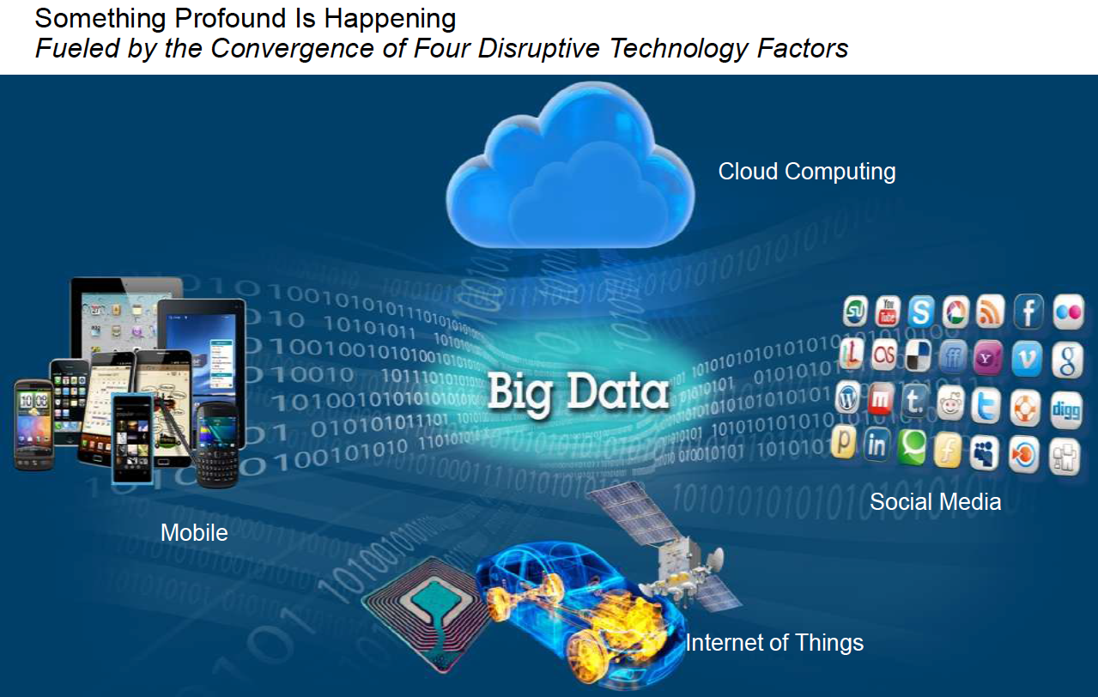
Reasons why you chose the Right class?
Stephen Brodsky, distinguished engineer and technical executive at IBM, 2013

Slide 31
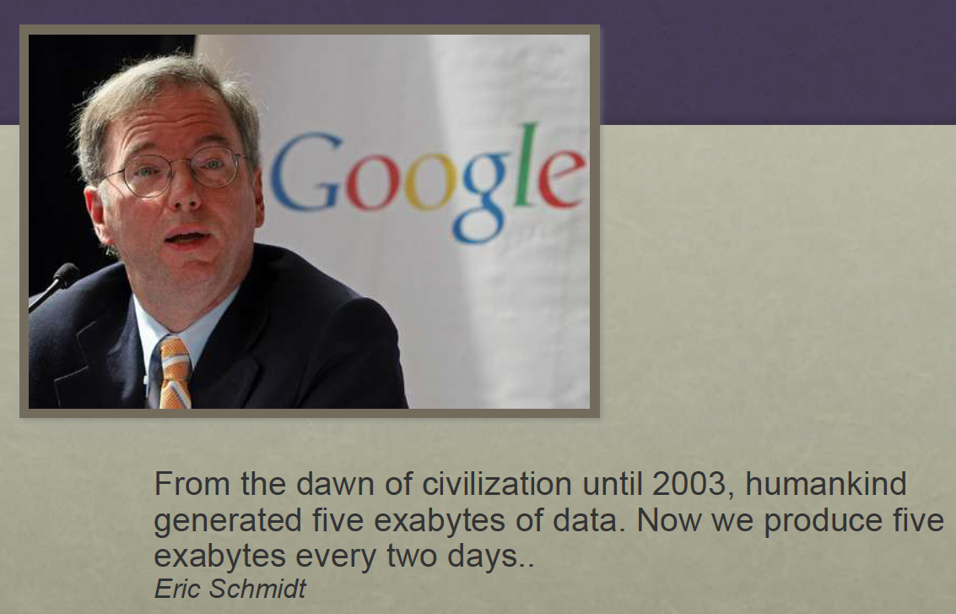
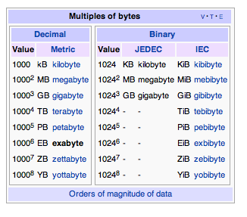
Big Data Age
Booch, 2013
Notes:
The world's technological per-capita capacity to store information has roughly doubled every 40 months since the 1980s;^{[9]} as of 2012, every day 2.5 exabytes (2.5×10¹⁸) of data are generated.[

Slide 32
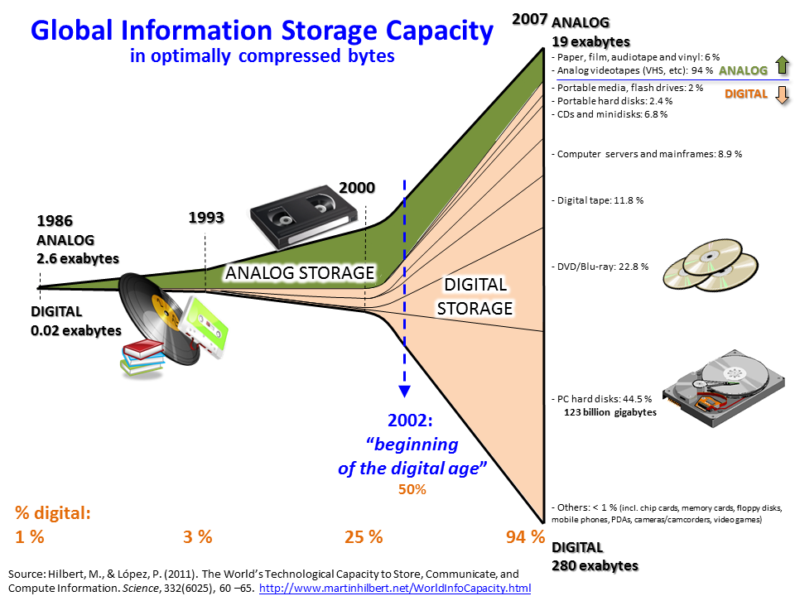
Wikipedia/images

Slide 33
Big Data Age
In the Scientific Research Community
Field | Source | Data Type
Physics | Large Hadron Collider [About LHC](2 mins) [LHC Data] (5 mins) | Collisions
Genomics | High-throughput instrument [Video] | DNA Sequence
Astronomy | Large Synoptic Survey Telescope(LSST) | Telescope images
Meteorology | Weather stations, ships, buoys, aircraft, radar, weather balloons, and satellite

Slide 34
Case Study 1: Physics, Collisions in LHC
Particles collide in the Large Hadron Collider (LHC) detectors approximately 1 billion times per second, generating about one petabyte of collision data per second. A 'trigger' system is therefore used to filter the data and select those events that are potentially interesting for further analysis. 30 millions events to 100,000 events
Even after the drastic data reduction performed by the experiments, the CERN Data Centers processes on average one petabyte of data per day.
"If we wanted to keep all 30 million events per second we would need about 2,000 petabytes to store a typical 12-hour run. For a typical running year of 150 days uptime, this would mean almost 400,000 PetaByte = 400 ExaByte per year - a huge amount of data we would not be able to store," CERN research physicist”
1) https://home.cern/science/computing/storage
2) https://home.cern/news/news/computing/cern-data-centre-passes-200-petabyte-milestone#:~:text=Particles%20collide%20in%20the%20Large,of%20collision%20data%20per%20second

Slide 35
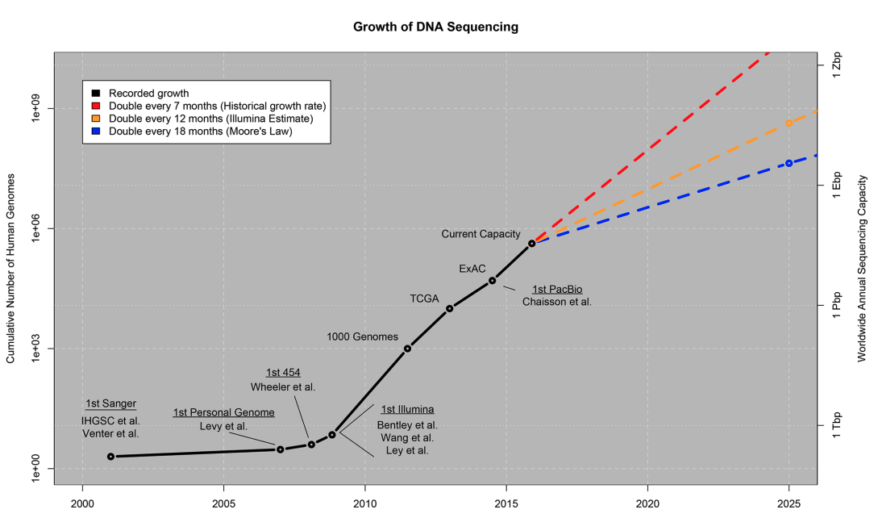
Case Study 2: Genomics
doi:10.1371/journal.pbio.1002195.g001

Slide 36

Reasons why you chose the Right class?
Lot’s of Jobs:
https://www.linkedin.com/jobs/data-mining-jobs/
https://www.glassdoor.com/Job/data-mining-jobs-SRCH_KO0,11.htm
https://www.indeed.com/q-Data-Scientist-jobs.html
Google.images

Slide 37

Questions?
Let’s have a great semester

Slide 38
Dive into R
Oluwatosin Oluwadare, Ph.D.

Slide 39
Introduction to R Programming
R is a comprehensive programming language, meaning that it provides services for statistical modeling as well as for software development.
R is the primary language for Data Science: powerful environment for data analysis, visualization, and statistical analysis
R is most widely used because of its wide availability of libraries. R has CRAN, which is a repository holding more than 10,0000 packages.
R is free an Open-source
R Possesses a Number of Graphical Libraries
R supports cross-platform compatibility.
R language is interpreted instead of compiled. Therefore, it does not need a compiler to compile code into an executable program.
Source: https://data-flair.training/blogs/features-of-r-programming/

Slide 40
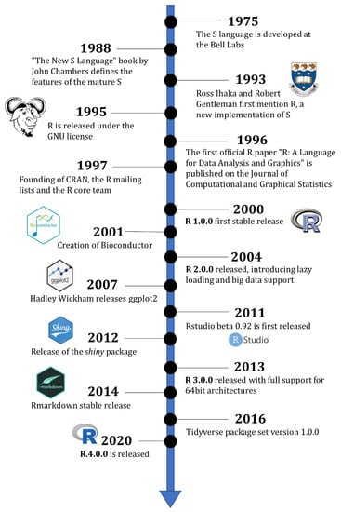
Timeline of R history with selected milestones.
Giorgi, F. M., Ceraolo, C., & Mercatelli, D. (2022). The R Language: An Engine for Bioinformatics and Data Science. Life, 12(5), 648.
Notes:
History of the R Programming Language by Giorgi, F. M., Ceraolo, C., & Mercatelli, D. (2022). The R Language: An Engine for Bioinformatics and Data Science. Life, 12(5), 648.

Slide 41
Introduction to R Programming
Through R, you can perform a wide variety of complex operations on vectors, arrays, data frames and other data objects of varying sizes.
R provides excellent data handling and storage facilities.

Slide 42
Package Resources Cheat sheet for R
The link below contains cheatsheets to find popular and useful R packages.
It is updated frequently as well.
https://posit.co/resources/cheatsheets/?type=posit-cheatsheets/

Slide 43
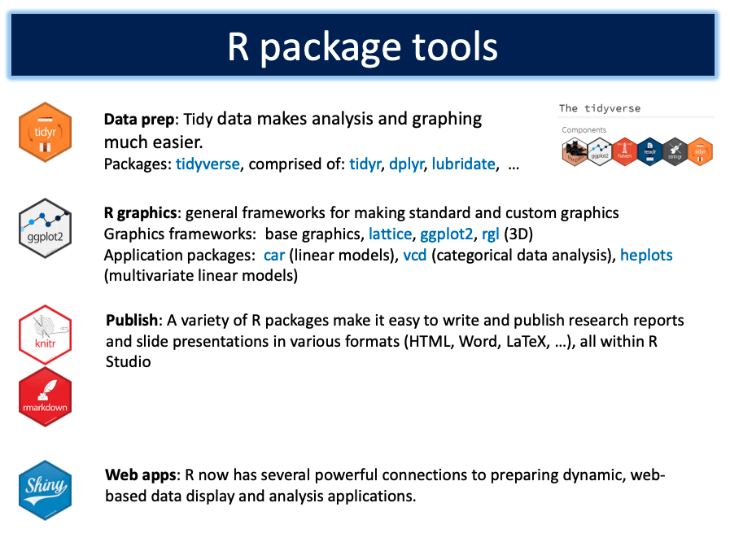
R Package Tools
Packages for R
Source: Michael Friendly

Slide 44
Extra Reading
Extra’s that will be beneficial for the currently discussed topic in class.
The R Language: An Engine for Bioinformatics and Data Science by by Giorgi, F. M., Ceraolo, C., & Mercatelli, D. (2022). The R Language: An Engine for Bioinformatics and Data Science. Life, 12(5), 648.
  Section 2: History of the R Programming Language

Slide 45
In Class Reading (30 Minutes)
Chapter 1. Read And Practice.
Skip the Learning Checks. We will review this together (1.1 to 1.4).

Slide 46
Variable Name is R
A variable's name might be short (like x and y) or longer (like encyclopedia, dictionary, school, etc).
Rules for R variables include:
A variable name must begin with a letter and may also contain numbers, punctuation, underscores (_), and periods (.). A number cannot come after something that is preceded by a period (.).
An underscore (_) or number cannot be used to begin a variable name.
Names of variables are case-sensitive (age, Age and AGE are three different variables)
No variables can be used with reserved terms (TRUE, FALSE, NULL, if...)

Slide 47
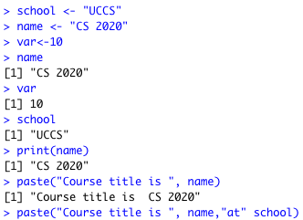
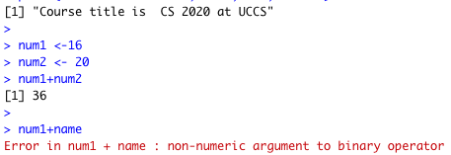

Simple Codes in R
Creating Variables
Variable names and spacing
Printing Variables (print)
Concatenate Elements (paste)

Slide 48
R Studio Directory
Set Your Working Directory in R studio:
  setwd(“path”)
Get Your Working Directory in R studio:
  getwd()

Slide 49
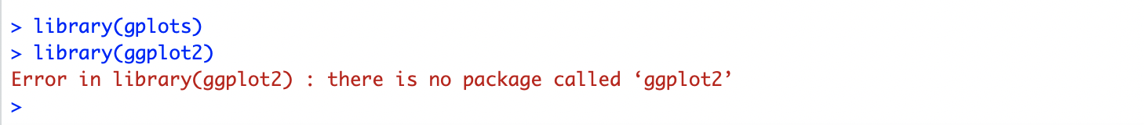
Discussion Points – Learning Check 1.1
Learning Check ( LC1.1): Needed for Chapter 3
Package Installation: (un) Successful Installations
Errors : likely causes: version differences, installation location, etc.

Slide 50
Discussion Points – Learning Check 1.2
Learning Check ( LC1.2):
Loading Packages: Errors and Success
  “Load” the dplyr, nycflights13, and knitr
If any errors in the loading of the other packages. Review how Learning Check 1 was handled.

Slide 51
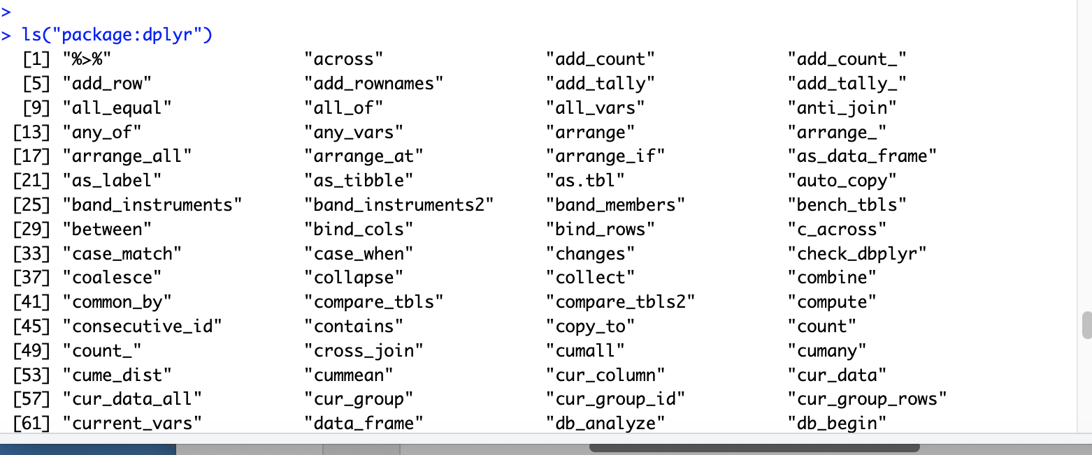
List functions in a package
> ls("package:dplyr")

Slide 52
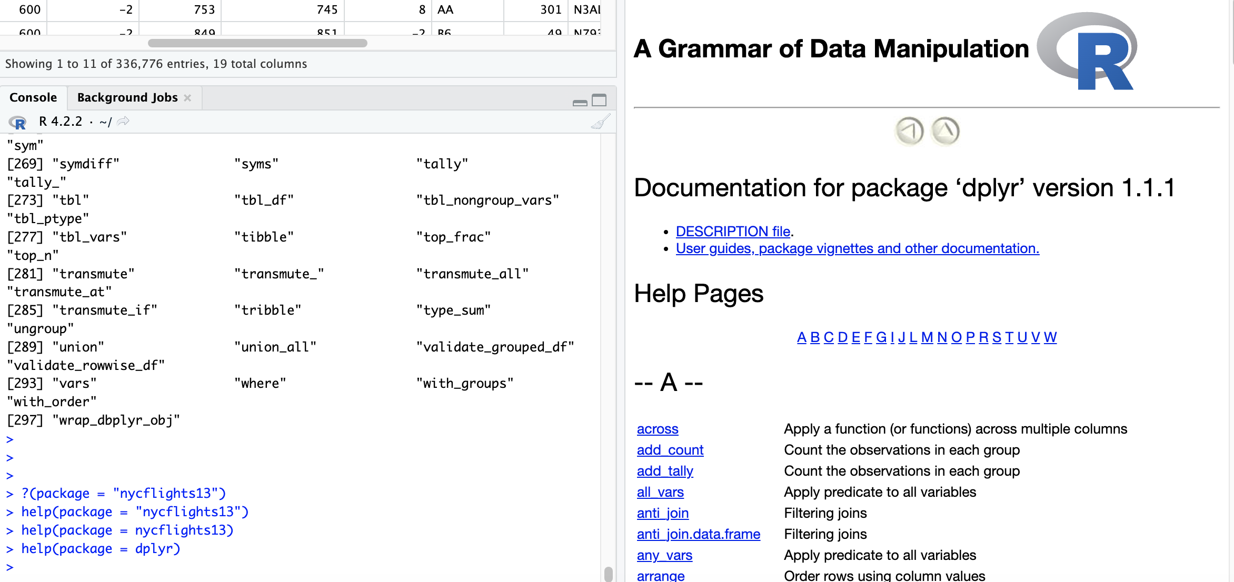
Help Files: Check Functions in a Package
Another nice feature of R is help files, which provide documentation for various packages, functions, and datasets.
help (package = dplyr) or help (package = “dplyr”)

Slide 53
Help Files:
Find documentation about a function or data frame
You can bring up help files by adding a ? before the name of a function or data frame and then run this in the console.
> help(flights)
>?flights

Slide 54
Section 1.4 : Random Questions
What is data frame?
  Data frames: rectangular spreadsheets. They are representations of datasets in R where the rows correspond to observations and the columns correspond to variables that describe the observations.

Slide 55
1.4.1: nycflights Data Frame
flights: Information on all 336,776 flights.
airlines: A table matching airline names and their two-letter International Air Transport Association (IATA) airline codes (also known as carrier codes) for 16 airline companies. For example, “DL” is the two-letter code for Delta.
planes: Information about each of the 3,322 physical aircraft used.
Weather
airports

Slide 56
Exploring Data Frames
Using the View() function, which brings up RStudio’s built-in data viewer.
Using the glimpse() function, which is included in the dplyr package.
Using the kable() function, which is included in the knitr package.
Using the $ “extraction operator,” which is used to view a single variable/column in a data frame.

Slide 57
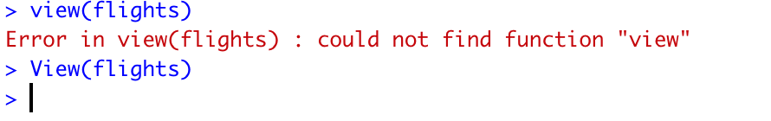
Discussion Points
R is Case-sensitive.
V in View().
You will get an error message if you run view(flights) instead of View(flights).

Slide 58
Discussion Points – Learning Check 3
(Submit Response on Canvas)
What does any ONE row in this flights dataset refer to?
  A. Data on an airline
  B. Data on a flight
  C. Data on an airport
  D. Data on multiple flights

Slide 59
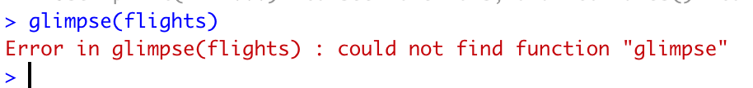
glimpse() function
Any reason why this will happen?
Failed to install the “dplyr” Package before calling the function.
One of the reasons I like the glimpse function is because it provides the variables’ datatypes

Slide 60
Categorical vs Quantitative Variables
In statistics, a categorical variable (also called qualitative variable) is a variable that can take on one of a limited, and usually fixed, number of possible values, assigning each individual or other unit of observation to a particular group or nominal category on the basis of some qualitative property.
Some of the variables like distance, day, and arr_delay are what we will call quantitative variables. These variables are numerical in nature.
Source: https://en.wikipedia.org/wiki/Categorical_variable

Slide 61
Examples of categorical variables
Common examples of values that might be represented in a categorical variable:
The roll of a six-sided dice: possible outcomes are 1,2,3,4,5, or 6.
The Blood Type of a person: A, B, AB or O.
Professor: Assistant, Associate, Full

Slide 62
Discussion Points – Learning Check 4 (Submit Response on Canvas)
What are some other examples in this dataset of categorical variables? What makes them different than quantitative variables?
Mention at least 2.

Slide 63
Discussion Points – Learning Check 5 &7 (Submit Response on Canvas)
What properties of each airport do the variables lat, lon, alt, tz, dst, and tzone describe in the airports data frame? Take your best guess.
Look at the help file for the airports data frame. Revise your earlier guesses about what the variables lat, lon, alt, tz, dst, and tzone each describe.

